Slide 1

Unit-6 Spark
Big Data Analytics(BDA)
GTU #3170722
Prof. Maulik D. Trivedi
Computer Engineering Department
maulik.trivedi@darshan.ac.in
9998 265 805

Slide 2

Looping
Outline
Introduction to Data Analysis with Spark
In-Memory Computing with Spark
Spark Basics
Interactive Spark with PySpark
Writing Spark Applications

Slide 3
Spark

Slide 4
Basics of Spark
Apache Spark is a lightning-fast cluster computing designed for fast computation.
It was built on top of Hadoop MapReduce and it extends the MapReduce model to efficiently use more types of computations which includes Interactive Queries and Stream Processing.
One of the main features Spark offers for speed is the ability to run computations in memory, but the system is also more efficient than MapReduce for complex applications running on disk.
Spark is designed to cover a wide range of workloads such as batch applications, iterative algorithms, interactive queries and streaming.
Apart from supporting all these workload in a respective system, it reduces the management burden of maintaining separate tools.
Spark is designed to be highly accessible, offering simple APIs in Python, Java, Scala, and SQL, and rich built-in libraries. It also integrates closely with other Big Data tools.
Spark can run in Hadoop clusters and access any Hadoop data source, including Cassandra.

Slide 5
Feature of Spark
Apache Spark has following features:
Speed
Spark helps to run an application in Hadoop cluster, up to 100 times faster in memory, and 10 times faster when running on disk.
This is possible by reducing number of read/write operations to disk.
It stores the intermediate processing data in memory.
Supports multiple languages
Spark provides built-in APIs in Java, Scala, or Python.
Therefore, you can write applications in different languages.
Spark comes up with 80 high-level operators for interactive querying.
Advanced Analytics
Spark not only supports ‘Map’ and ‘reduce’.
It also supports SQL queries, Streaming data, Machine learning (ML), and Graph algorithms.

Slide 6
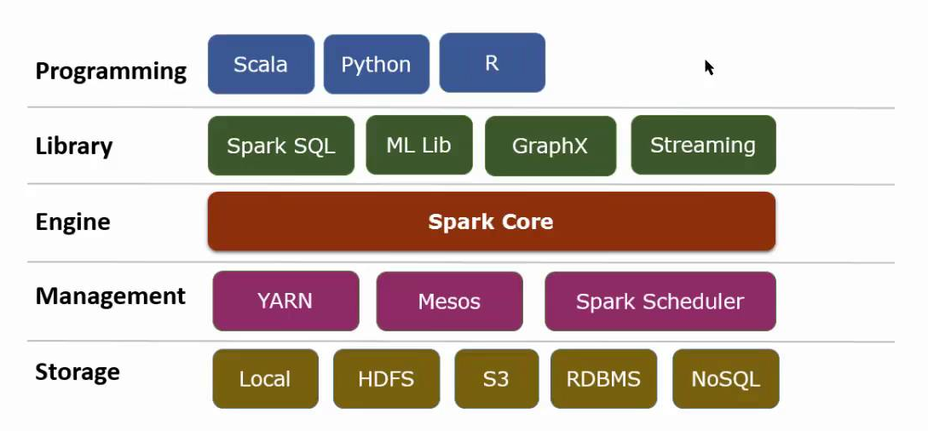
Spark Stack

Slide 7
Spark Stack – Cont.
Cluster Managers
The design of spark is efficiently scale up from one to thousands of computer nodes.
To achieve this while maximum flexibility, Spark may executer variety of cluster managers, including Apache Mesos, Hadoop Yarn and simple cluster manager comprised in Spark itself is known s the Standalone Scheduler.
Spark support for these types of cluster managers permits your application to run on them.

Slide 8
Spark Stack – Cont.
Apache Spark Core
Spark Core is the underlying general execution engine for spark platform that all other functionality is built upon. It provides In-Memory computing and referencing datasets in external storage systems.

Slide 9
Spark Stack – Cont.
Spark SQL
Spark SQL is a component on top of Spark Core that introduces a new data abstraction called SchemaRDD, which provides support for structured and semi-structured data.

Slide 10
Spark Stack – Cont.
Spark Streaming
Spark Streaming leverages Spark Core's fast scheduling capability to perform streaming analytics. It ingests data in mini-batches and performs RDD (Resilient Distributed Datasets) transformations on those mini-batches of data.

Slide 11
Spark Stack – Cont.
MLlib (Machine Learning Library)
MLlib is a distributed machine learning framework above Spark because of the distributed memory-based Spark architecture.
It is, according to benchmarks, done by the MLlib developers against the Alternating Least Squares (ALS) implementations.
Spark MLlib is nine times as fast as the Hadoop disk-based version of Apache Mahout (before Mahout gained a Spark interface).

Slide 12
Spark Stack – Cont.
GraphX
GraphX is a distributed graph-processing framework on top of Spark.
It provides an API for expressing graph computation that can model the user-defined graphs by using Pregel abstraction API.
It also provides an optimized runtime for this abstraction.

Slide 13
Spark Architecture
Apache Spark has a well-defined multi-layer architecture in which all Spark components and layers are loosely coupled.
The architecture is further integrated with various extensions and libraries.
The Apache Spark architecture is based on two main abstractions:
Resilient Distributed Dataset (RDD)
Directed Acyclic Graph (DAG)

Slide 14
Resilient Distributed Dataset(RDD)
RDDs are the building blocks of any Spark application.
RDDs Stands for:
Resilient: Fault tolerant and is capable of rebuilding data on failure
Distributed: Distributed data among the multiple nodes in a cluster
Dataset: Collection of partitioned data with values
It is a layer of abstracted data over the distributed collection.
It is immutable in nature and follows lazy transformations.
Once you create an RDD it becomes immutable. An object whose state cannot be modified after it is created, but they can surely be transformed.
RDDs are highly resilient, i.e, they are able to recover quickly from any issues as the same data chunks are replicated across multiple executor nodes.
Even if one executor node fails, another will still process the data.
Notes:
Now you might be wondering about its working. Well, the data in an RDD is split into chunks based on a key. RDDs are highly resilient, i.e, they are able to recover quickly from any issues as the same data chunks are replicated across multiple executor nodes. Thus, even if one executor node fails, another will still process the data. This allows you to perform your functional calculations against your dataset very quickly by harnessing the power of multiple nodes.

Slide 15
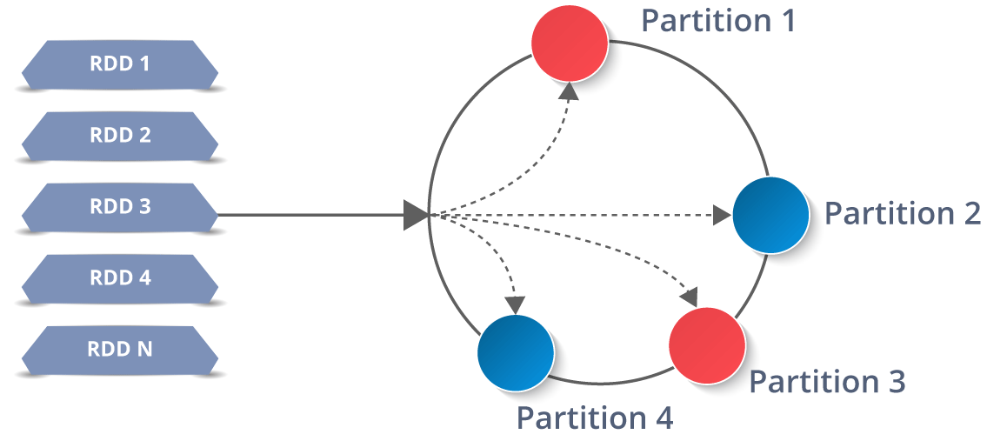
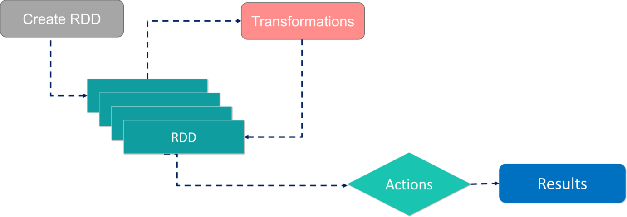
Resilient Distributed Dataset(RDD) – Cont.
In distributed environment, each dataset in RDD is divided into logical partitions, which may be computed on different nodes of the cluster.
Due to this, you can perform transformations or actions on the complete data parallelly.
Also, you don’t have to worry about the distribution, because Spark takes care of that.

Slide 16

Two ways to create RDDs
There are two ways to create RDDs − parallelizing an existing collection in your driver program, or by referencing a dataset in an external storage system, such as a shared file system, HDFS, HBase, etc.
With RDDs, you can perform two types of operations:
Transformations: They are the operations that are applied to create a new RDD.
Actions: They are applied on an RDD to instruct Apache Spark to apply computation and pass the result back to the driver.

Slide 17
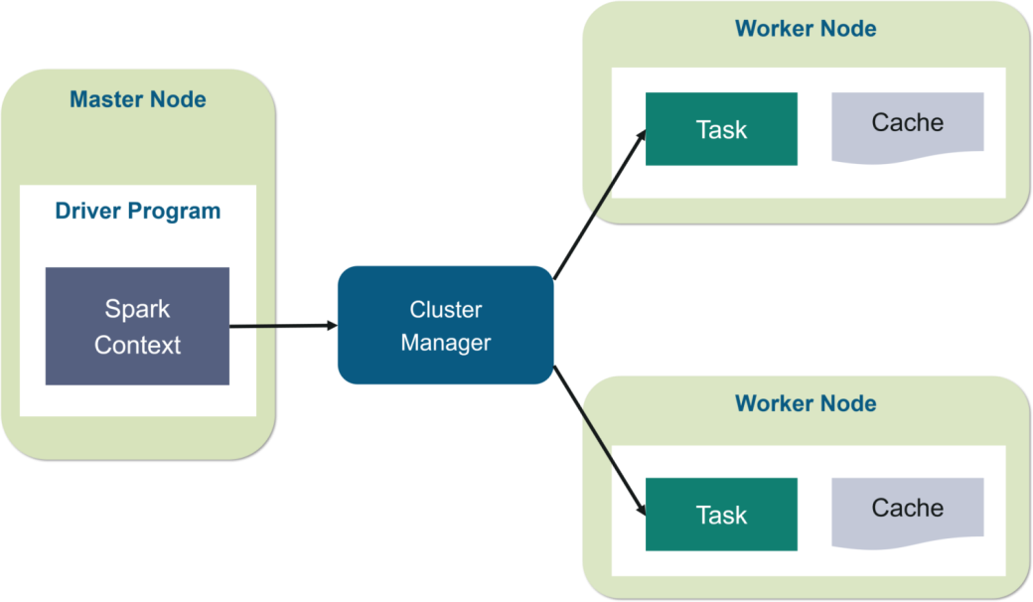
Working of Spark Architecture – Master Node
Master node have the driver program, which drives your application.
The code you are writing behaves as a driver program or if you are using the interactive shell, the shell acts as the driver program.
Driver program, which create a Spark Context. It is a gateway to all the Spark functionalities.
It is similar to your database connection. Any command you execute in your database goes through the database connection. Likewise, anything you do on Spark goes through Spark context.
Spark context works with the cluster manager to manage various jobs.
The driver program & Spark context takes care of the job execution within the cluster.
A job is split into multiple tasks which are distributed over the worker node.
Anytime an RDD is created in Spark context, it can be distributed across various nodes and can be cached there.

Slide 18
Working of Spark Architecture – Worker Nodes
Worker nodes are the slave nodes whose job is to basically execute the tasks.
These tasks are then executed on the partitioned RDDs in the worker node and hence returns back the result to the Spark Context.
Spark Context takes the job, breaks the job in tasks and distribute them to the worker nodes.
These tasks work on the partitioned RDD, perform operations, collect the results and return to the main Spark Context.
If you increase the number of workers, then you can divide jobs into more partitions and execute them parallelly over multiple systems. It will be a lot faster.
With the increase in the number of workers, memory size will also increase & you can cache the jobs to execute it faster.

Slide 19
Interactive Spark with PySpark
PySpark is the Python API to use Spark. Spark is an open-source, cluster computing system which is used for big data solution. It is lightning fast technology that is designed for fast computation.
PySpark is a Python API to support Python with Apache Spark. PySpark provides Py4j library, with the help of this library.
Python can be easily integrated with Apache Spark.
PySpark plays an essential role when it needs to work with a vast dataset or analyze them.
This feature of PySpark makes it a very demanding tool among data engineers.

Slide 20
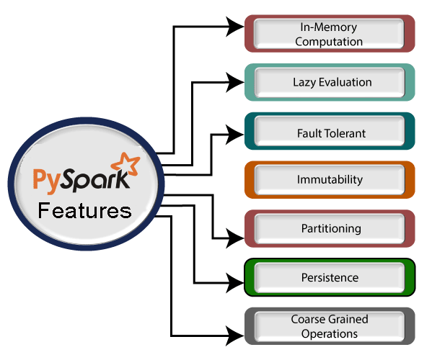
PySpark
Real-time Computation
PySpark provides real-time computation on a large amount of data because it focuses on in-memory processing. It shows the low latency.
Support Multiple Language
PySpark framework is suited with various programming languages like Scala, Java, Python, and R. Its compatibility makes it the preferable frameworks for processing huge datasets.
Caching and disk constancy
PySpark framework provides powerful caching and good disk constancy.
Swift Processing
PySpark allows us to achieve a high data processing speed, which is about 100 times faster in memory and 10 times faster on the disk.
Works well with RDD
Python programming language is dynamically typed, which helps when working with RDD. We will learn more about RDD using Python in the further tutorial.

Slide 21
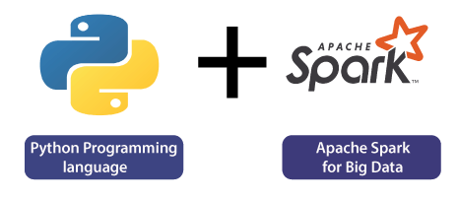
Why PySpark?
A large amount of data is generated offline and online.
These data contain the hidden patterns, unknown correction, market trends, customer preference and other useful business information.
It is necessary to extract valuable information from the raw data.
We require a more efficient tool to perform different types of operations on the big data.
It is needed some scalable and flexible tools to crack big data and gain benefit from it.

Slide 22
Application of PySpark
Entertainment Industry
Commercial Sector
Healthcare
Trades and E-commerce
Tourism Industry

Slide 23
Big Data Analytics(BDA)
GTU #3170722
Prof. Maulik D Trivedi
Computer Engineering Department
maulik.trivedi@darshan.ac.in
9998 265 805

